Slide 1
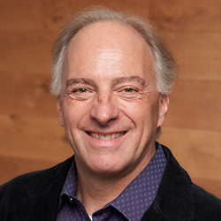

Welcome to CS 310 – Fall 2024
“Scalable Software Architectures”
Professor Joe Hummel
Professor of Instruction
Office: Tech L365
Pronouns: he/him
How to address: Professor Hummel or Professor Joe

Slide 2
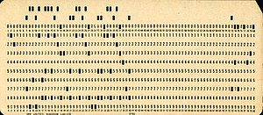


A little bit about me…
I'm relatively new at NU --- my 3rd year
I’ve been teaching CS for over 25 years, and programming for over 45 years
Yes, I wrote computer programs using punch cards
I'm an avid cyclist and sailor
Cycled around Italy (Tuscany region) in June
Sailed around Lake Michigan in July/August

Slide 3

Class goals
Cloud-native applications
Scalable architectures
Designs
Trade-offs
Build prototypes
Languages: JavaScript, Python, SQL
Focus on server-side, not client-side

Slide 4
Flipped Classroom
I'm trying something new this quarter…
Flipped classroom =>
Lectures recorded and viewed outside of class time
Class sessions focus on demos, problem solving, live coding, discussions, general Q&A
Why?
Class attendance was hitting 10% --- everyone was reviewing PPT or class recordings outside of class
Theory better presented via PPT / recordings (?), spend more time in class on the application

Slide 5
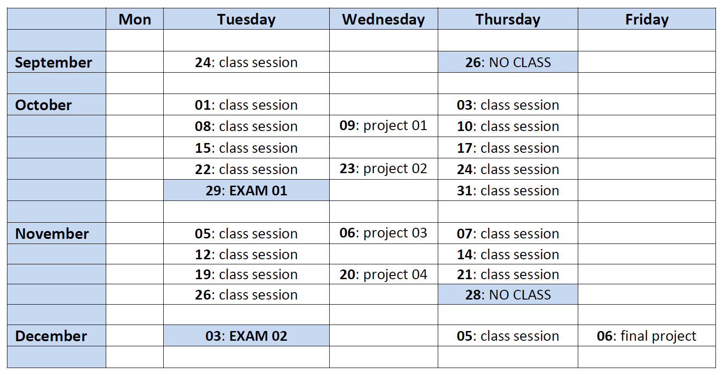
Summary of class…
Projects (individual): 56%
Exam: 15%
Exam: 15%
Final Project (teams): 14%

Slide 6
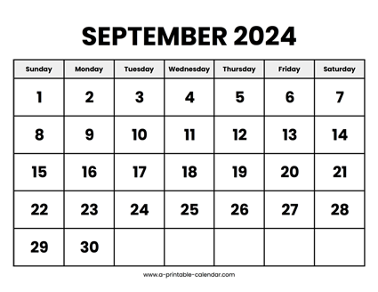
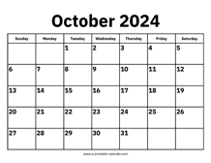
Next two weeks…
Notes:
Read through the syllabus on Canvas
No class on Thursday September 26th
Lecture recordings will start to post this weekend…
Flipped classroom starts Tuesday, Oct 1st
Look on Canvas for class session topics
Example: Tues 10/1 will be databases and SQL
Class sessions are NOT recorded
Afternoon class session will start @ 3:45 (not 3:30)
Project 01 due Wednesday October 9th
Not yet available, will be released in a couple days

